Slide 1
Disaster Recovery

Slide 2
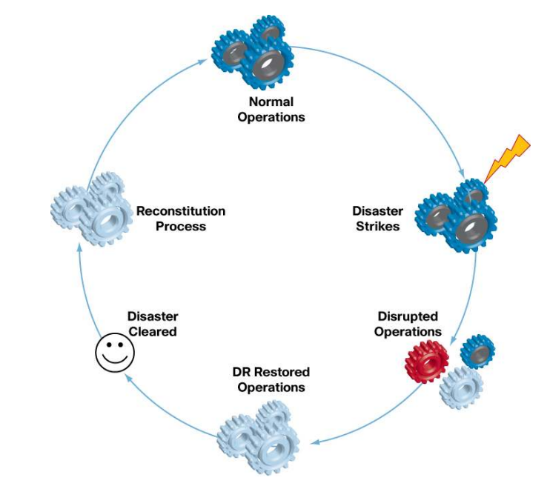
Disasters are inevitable but mostly unpredictable, and they vary in type and magnitude

Slide 3
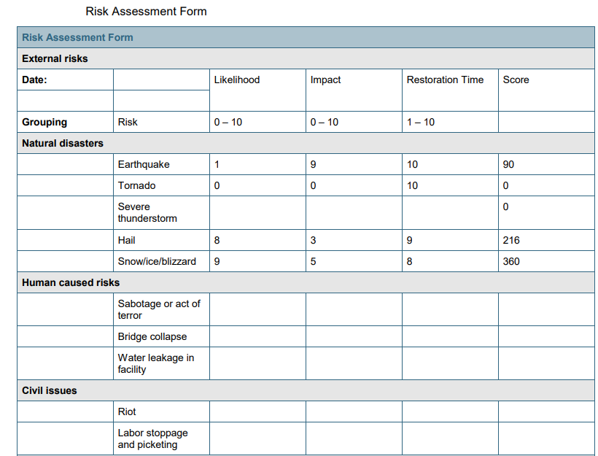
Disaster Recovery Planning
Identification and Analysis of Disaster Risks/Threats
Risk attributes : Time/day , impact , Scope etc
Classification of Risks Based on Relative Weights
External Risks ,Facility Risks , Data Systems Risks
Building the Risk Assessment

Slide 4
Disaster Recovery Planning
Determining the Effects of Disasters
Evaluation of Disaster Recovery Mechanisms
Disaster Recovery Committee

Slide 5
Disaster Recovery Phases
Activation Phase: In this phase, the disaster effects are assessed and announced
The activation phase involves:
Notification procedures
Damage assessment
Disaster recovery activation planning
Execution Phase: In this phase, the actual procedures to recover each of the disaster affected entities are executed. Business operations are restored on the recovery system
Recovery operations start just after the disaster recovery plan has been activated, appropriate operations staff have been notified, and appropriate teams have been mobilized. The activities of this phase focus on bringing up the disaster recovery system.
Reconstitution Phase: In this phase the original system is restored and execution phase procedures are stopped
In the reconstitution phase, operations are transferred back to the original facility once it is free from the disaster aftereffects, and execution-phase activities are subsequently shut down. If the original system or facility is unrecoverable, this phase also involves rebuilding.

Slide 6
The Disaster Recovery Plan Document
Document Contents
Document Information
Purpose
Scope
Assumptions
Document Maintenance
Periodic Mock Drills
Experience Capture
Periodic Updates

